Slide 1
CIS 4526 Foundations of Machine Learning
Chapter 12
Clustering

Slide 2
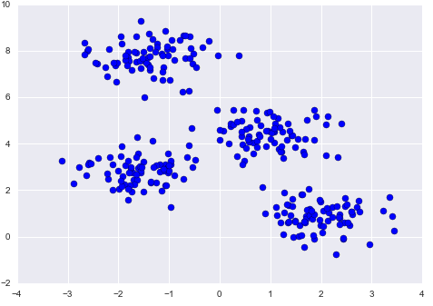
Clustering
Unsupervised Learning
Goal of clustering is to group set of objects based on similar characteristics
Help find meaningful structure among your data, group similar data together and discover underlying patterns

Slide 3
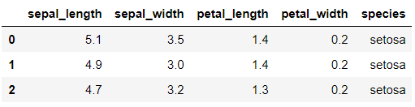
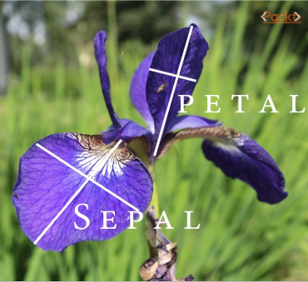
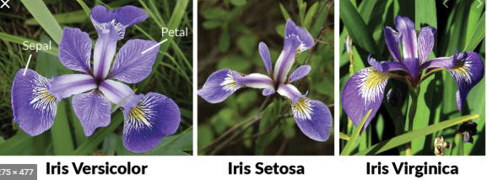
Iris dataset

Slide 4
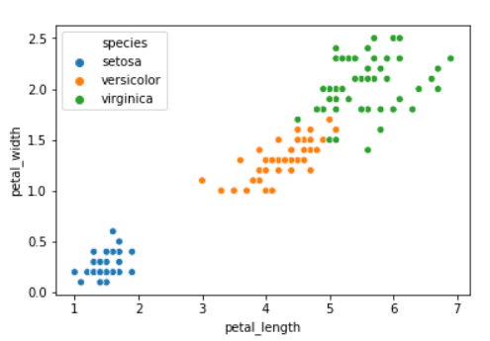
Iris dataset

Slide 5
K-Means Algorithm
Pick a value for k (the number of clusters to create)
Initialize k ‘centroids’ (starting points) in your data
Create your clusters. Assign each point to the nearest centroid.
Make your clusters better. Move each centroid to the center of its cluster.
Repeat steps 3–4 until your centroids converge.
https://www.youtube.com/watch?v=_aWzGGNrcic
Starting from 4:20

Slide 6
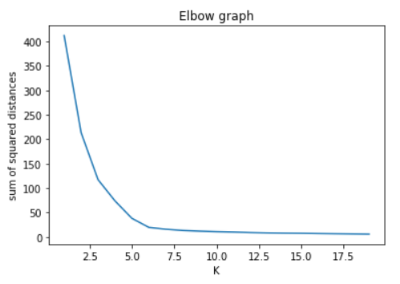
How to choose K?
Sum of squared distance of each data point to its closest centroid should be small if our clusters make sense
So if try different value of K, this sum of squared should decreases
After certain value of K, the marginal benefit of adding more cluster would not help
The resulting graph looks like an elbow and one can pick K by looking at the point of inflection. The graph is called an elbow graph

Slide 7
K-Means Clustering
Learning by doing

